Slide 1

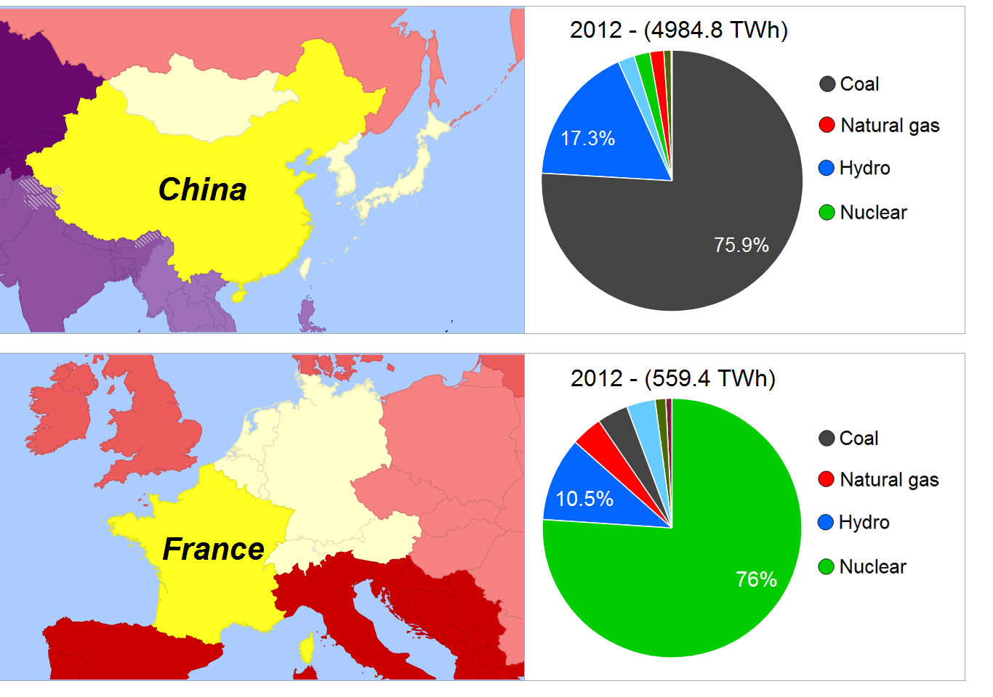
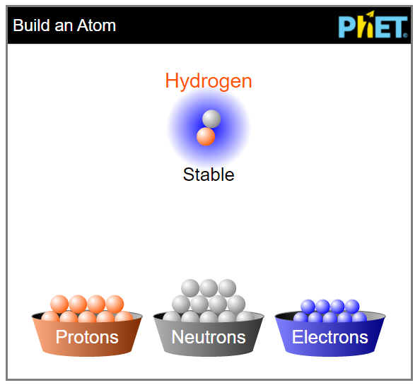
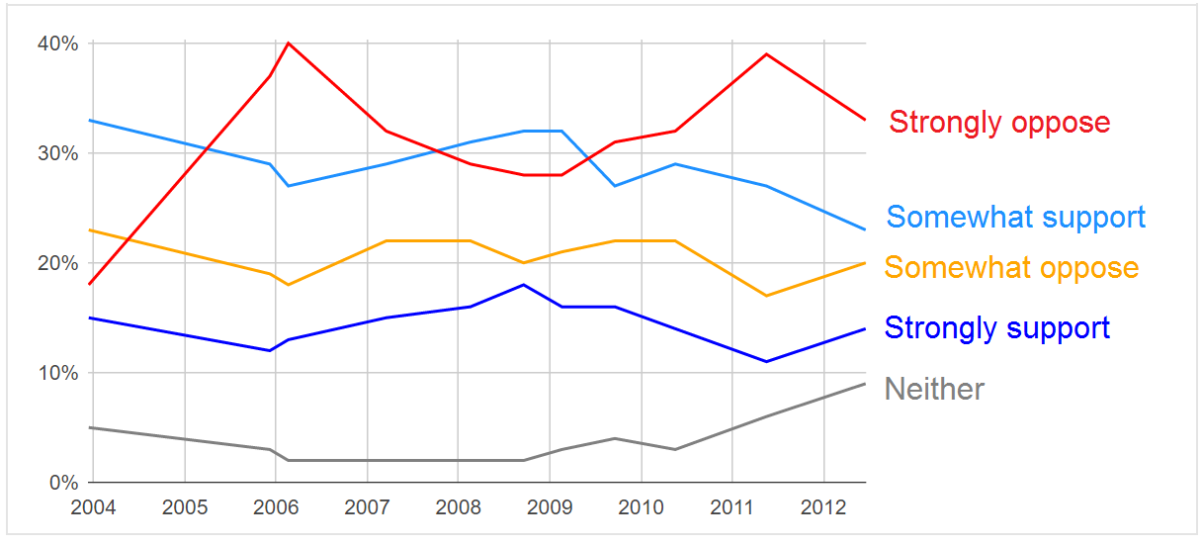
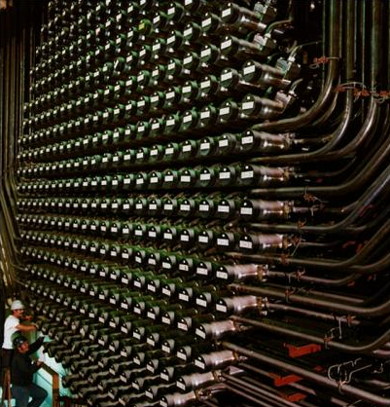
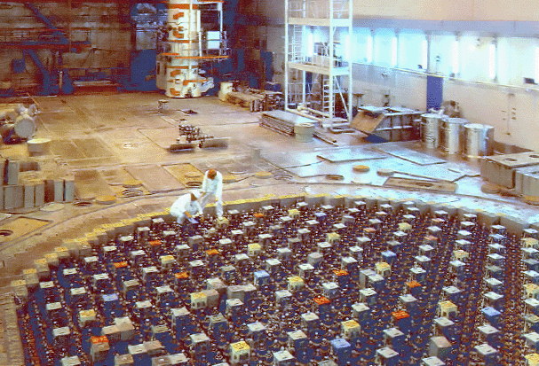

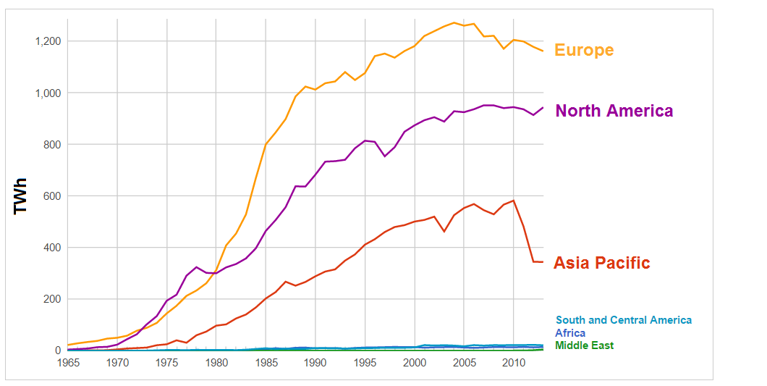
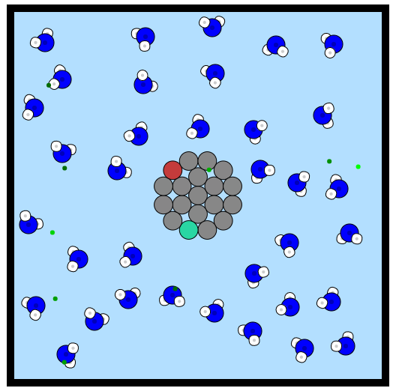

Nuclear Education for the Public:
Interactive tools for self-directed learning
J. Hanania, J. Williams, K. Stenhouse, B. Heffernan, J. Jenden, E. Lloyd, J. Toor, G. Dharan, and J.M.K.C. Donev
www.EnergyEducation.ca
Introduction
Dynamic Content
Nuclear Science
EnergyEducation.ca covers all areas of the energy sector. All sources of energy are explored neutrally, allowing factually-driven information to guide user’s learning.
Over 900 pages of content geared towards adult Canadians
Energy sources can be seen in the context of one another
Free to use around the globe, with users in 100+ countries
Custom visualization tools, graphics and simulations
Dozens of graphics and visualization tools engage users and guide their attention
Over 50 nuclear-specific pages give users foundations in nuclear science
Visualization tools are embedded throughout the content pages, delivering complex topics in an appealing and informative way.
With information on general topics like what a nucleus is, to specifics of global electricity contributions, even an expert in nuclear science can get meaningful knowledge from this resource.
Topics include:
Fundamental physics
Basic nuclear science
Nuclear reactor specifics
Nuclear accidents
  Chernobyl
  Three Mile Island
  Fukushima
Country-by-country electricity sources
Attitudes around nuclear are mostly negative
Canadian views of nuclear power are often based on what is heard through the media, resulting in misinformed opinions. Education about nuclear energy is crucial for informed discussions to take place.
Canadian support for nuclear power
Figure 5. Users have the ability to build atoms and nuclei to test stability and other nuclear properties. [2]
Nuclear waste management
Figure 6. Images of the maintenance of two nuclear reactors featured on the reactor pages: CANDU (left) and
RBMK (right). [3,4]
Scan the code to access the visualization!
Figure 3. This interactive visualization shows the world’s electricity generation by energy source. Individual countries can be selected from the map allowing the user to see where each country gets their electricity. Time series data shows how electricity generation has changed over time, demonstrating trends of high fossil fuel use around the globe.
Figure 1. Surveys show that the majority of Canadians (53%) opposed nuclear power in 2012, with similar results in years prior. [1]
Conclusion
Nuclear energy growth has halted worldwide
As of date, the site has received over 70,000 unique visits. In addition to being used for 10 University of Calgary courses, including the “Intro to Nuclear Power” and “Intro to Energy” course, the encyclopedia has been used at 6 other universities. Future goals include doubling the number of outside institutions using the site.
Fission and moderation simulation
Figure 4. This custom-made simulation demonstrates the workings of a simple fission reactor. Neutrons are moderated by heavy water and absorbed by U-235 if moving slow enough (red flash) or U-238 if going too fast (blue flash). Red flashes represent fission events, and release 2 more fast neutrons.
References
Figure 1 data. Canadian Nuclear Association (2012, June). 2012 Public Opinion Research – National Nuclear Attitude Survey [Online].
PhET Interactive Simulations. University of Colorado.
Figure 6 (left). Introduction to CANDU 6- Part 3 Moderator, HTS, Heavy Water, by D.A. Meneley and Y.Q. Ruan. [Online].
Figure 6 (right) by Argonne National Laboratory (Argonne National Laboratory: [1]) [Public domain], via Wikimedia Commons
Scan the code to access the simulation!
Figure 2. Global consumption has tapered off in recent years, partly due to similar negative public views. (Graph via energyeducation.ca)
We would like to acknowledge the Faculty of Science and the School
of Public Policy at the University of Calgary.

